Slide 1
Virtual Cloud Network
Oracle Cloud Infrastructure

Slide 2
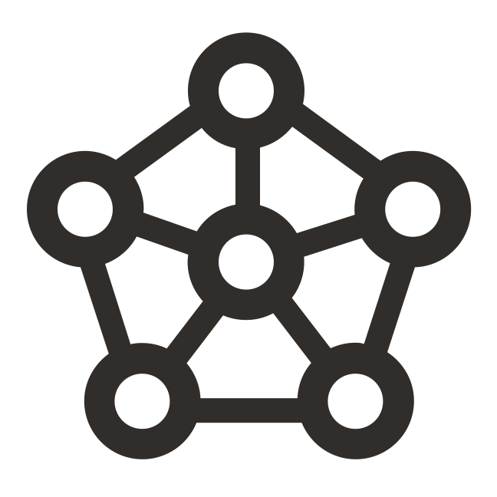


VCN & Subnets
ORACLE CLOUD DATA CENTER REGION
AVAILABILITY DOMAIN-1
AVAILABILITY DOMAIN-2
AVAILABILITY DOMAIN-3
DRG_Vpn
Hub_vcn
10.255.51.255/28
Net_vcn 10.255.51.0/24
Net_compartment
Subnet_DB
10.255.51.0/26
DB_vcn
DB_compartment

Slide 3
VCN Peering
Enables connectivity between the resources in different VCNs
Does not require public IPs or NAT to enable connectivity
Traffic never leaves the Oracle Network
Over other options such as connecting over the internet, VCN Peering offers
Faster connectivity
Higher security
Types of VCN Peering available
Local Peering (In-region)
Remote Peering (Cross-region)

Slide 4
Local VCN Peering – connecting VCNs in the same region
Connecting two VCNs in the same region so that their resources can communicate using private IP addresses without routing the traffic over the internet or through your on-premises network.
VCNs should not have overlapping IP addresses
Local Peering VCNs can be either in the same or different tenancies (cross-tenancy peering)
Local Peering Gateway (LPG)
Like the Internet Gateway, LPG is a component on the VCN
LPGs of two VCNs are connected to make a peering relationship
Enable the data plane to learn about instances in peered VCNs

Slide 5
Remote VCN Peering – connecting VCNs in the different region
Traffic flows between regions through the OCI backbone network
Supported between ASH – PHX and LHR-FRA, other regions on roadmap.
The two VCNs in the peering relationship must not have overlapping CIDRs
Requires a DRG to set up the Remote Peering connection; vNIC of one VCN instance forwards traffic to its DRG, which forwards traffic to peer DRG in other region over backbone
Enables features such as data replication across regions
Remote Peering Connection
Like Virtual Circuits, the Remote Peering Connection is a component of DRG
RPCs of two DRGs from two regions are connected to create a peering relationship

Slide 6
VCN Peering Link and Demos
Demo to build Local Peering
https://learn.oracle.com/ols/course/oracle-cloud-infrastructure-architect-associate-workshop/35644/80259/102540
Demo remote peering
https://www.youtube.com/watch?v=2TOL5tJQ-fU
Demo transit routing Local+Remote Peering
https://learn.oracle.com/ols/course/oracle-cloud-infrastructure-architect-professional-workshop/35644/86765/123287
A-Team doc
https://www.ateam-oracle.com/interconnect-tenancies-across-regions#_Introduction

